Slide 1
Intro to MDP and GPI methods
0712238 林彥彤
for 無限數學研究社

Slide 2

What is ai?

Slide 3
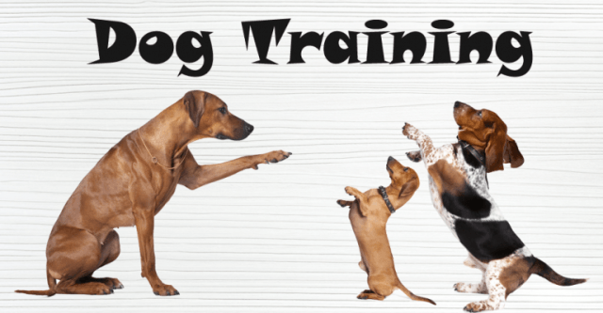
Reinforcement Learning
iamge from https://www.bunkandbiscuit.net/training
Notes:
養狗 訓練狗 食物 reward action environment

Slide 4
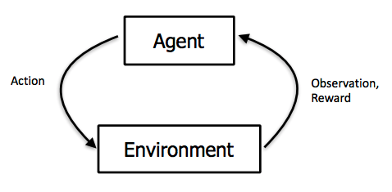
Reinforcement Learning(cont.)
Notes:
狗的例子 那要如model更多情形

Slide 5
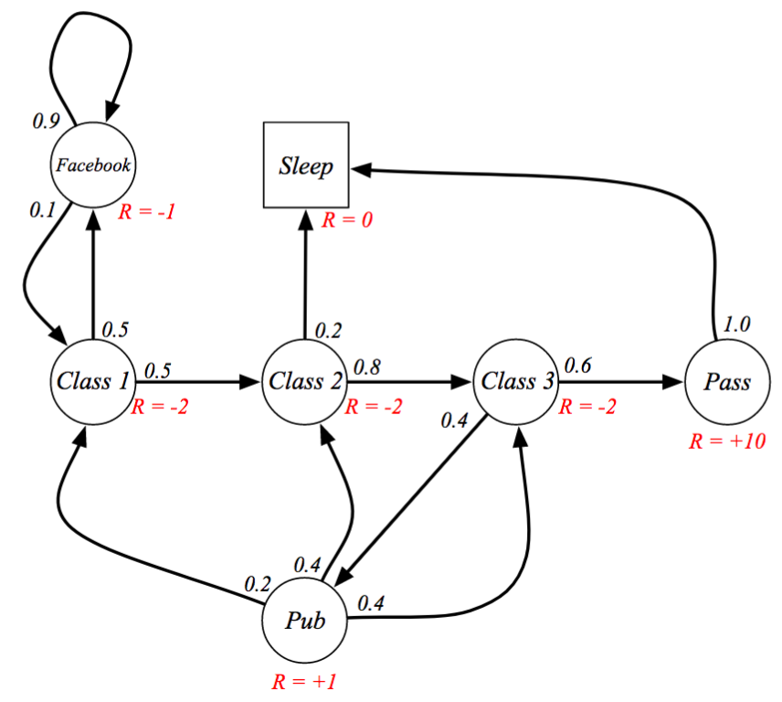
Markov Chain - a way to model the env.
Notes:
講解圖片 高中的轉移矩陣

Slide 6
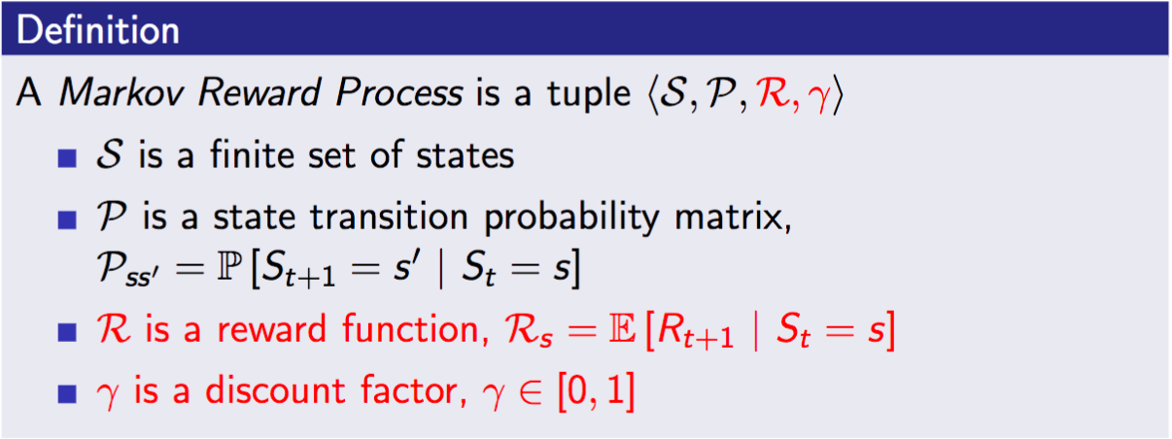
Markov Reward Processes
Notes:
加上reward

Slide 7
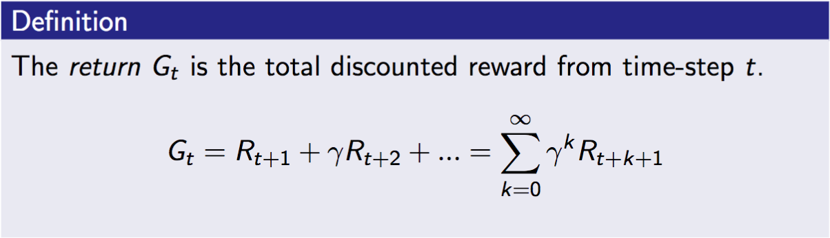
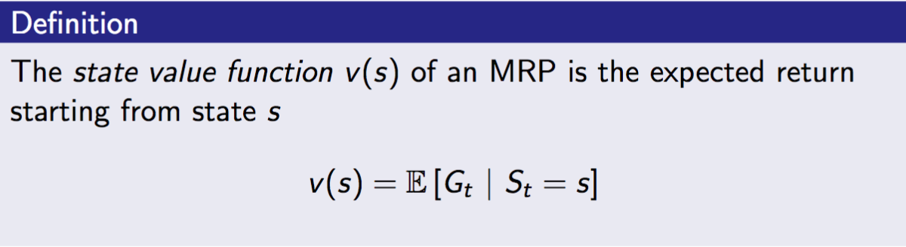
State Value

Slide 8
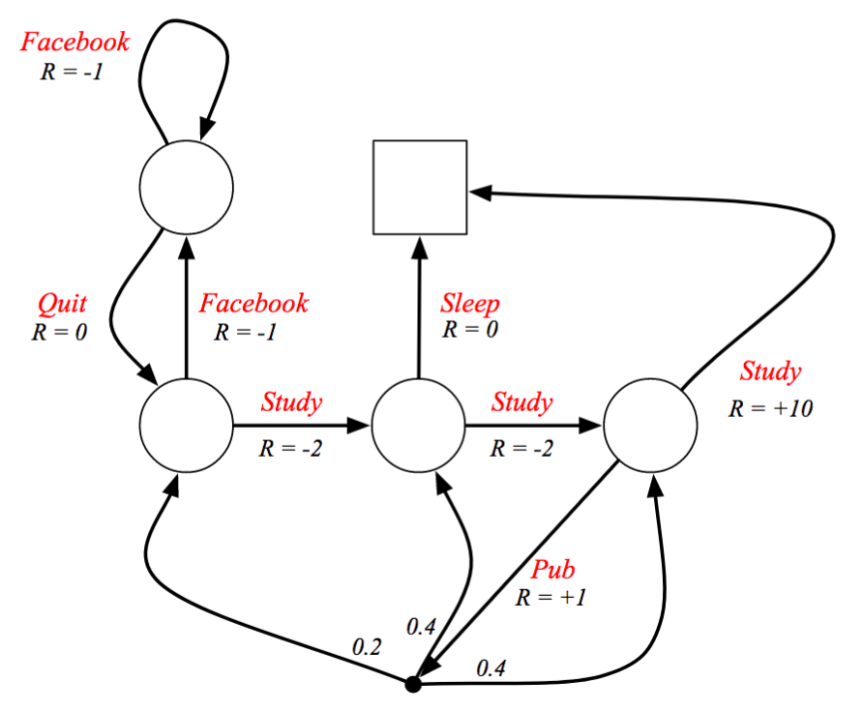
NO “floating” in the process => Action

Slide 9
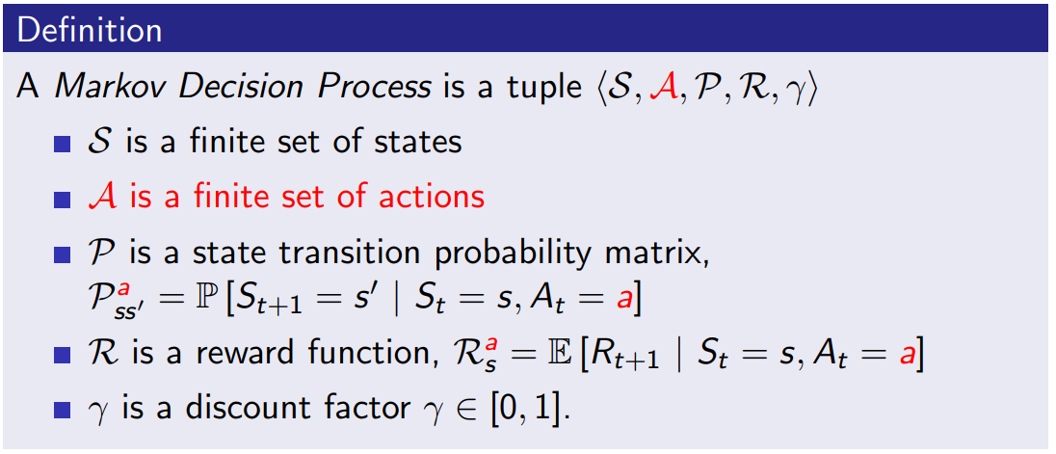
Markov Decision Process
Notes:
詳細解釋定義 math come in

Slide 10
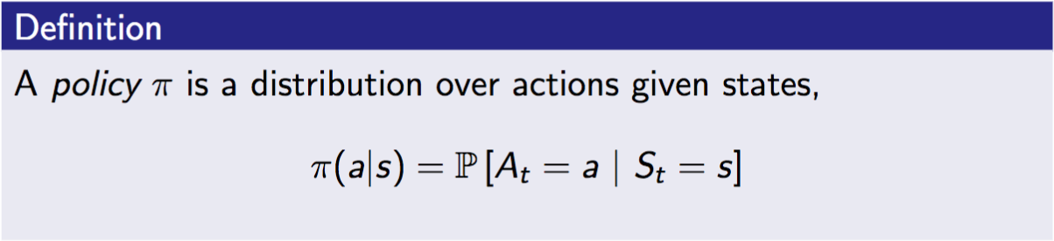
Policy - given state, what is ur action

Slide 11
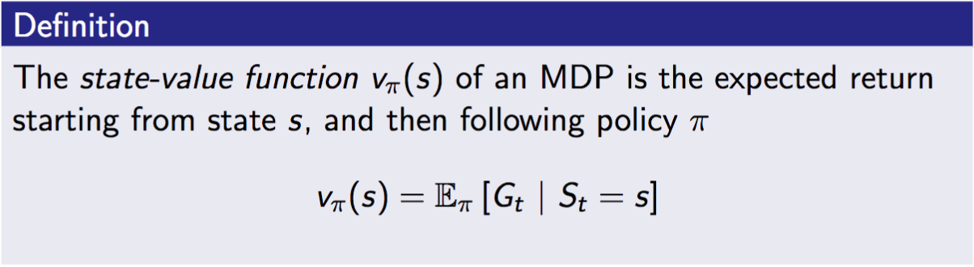
Value given Policy

Slide 12
Question!
How do we choose “GOOD” actions?
i.e.
How to improve our POLICY?

Slide 13
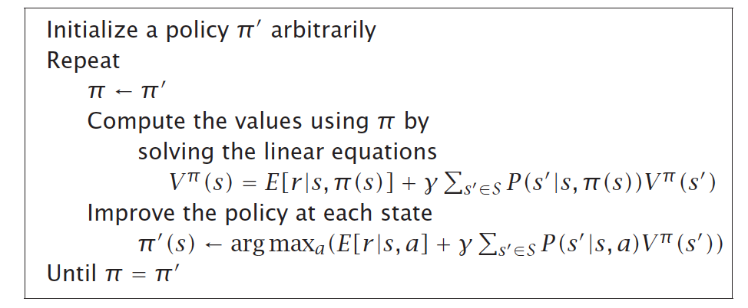
DP!!
proved with contraction mapping theorem
Notes:
可以稍微提到DP
主要是講說用之前的讓接下來的更好

Slide 14
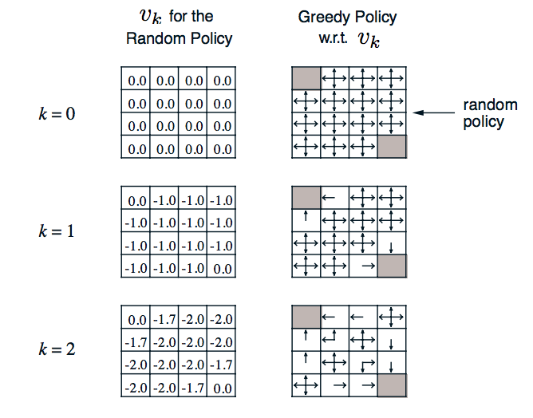
Code Demo
Notes:
demo ipython on DP grid world

Slide 15
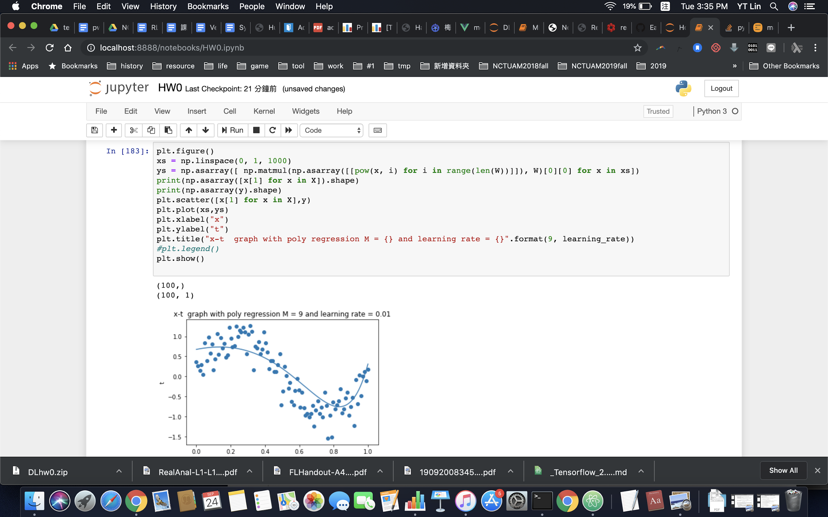
Code Demo(cont.) - jupyter notebook
pip3 install jupyter => bash$ jupyter notebook
pip3 install gym
this picture is not policy iteration btw

Slide 16
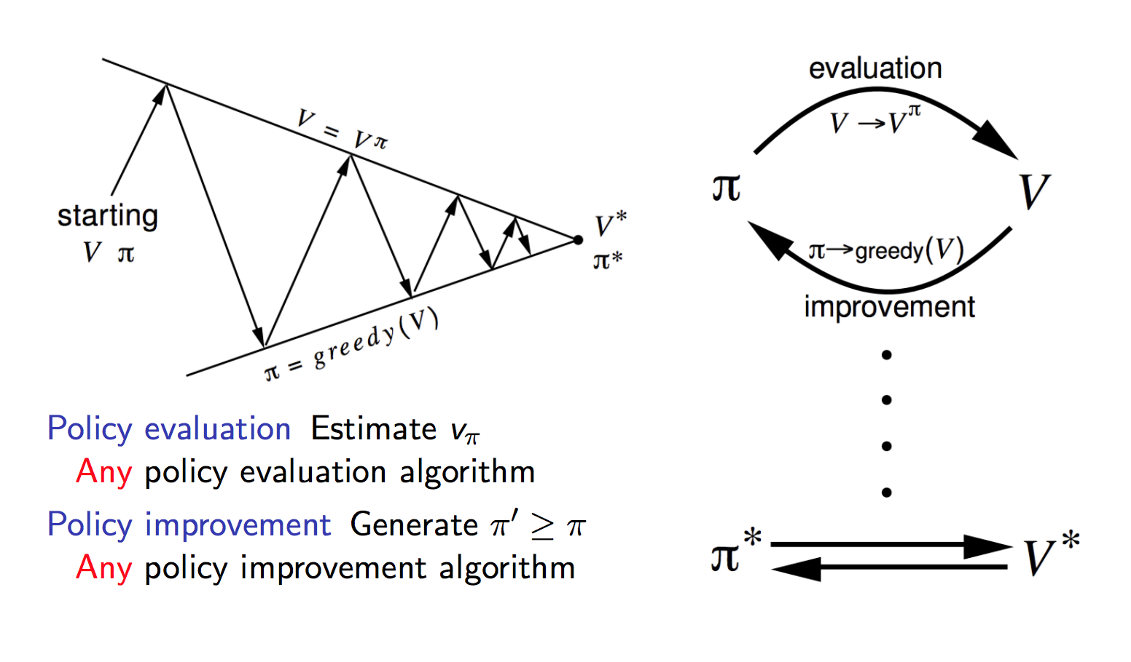
Generalized Policy Iteration

Slide 17
More….
What if you don’t know the exact Markov Chain….
What if the States are too many to record……
hint : function approximation

Slide 18
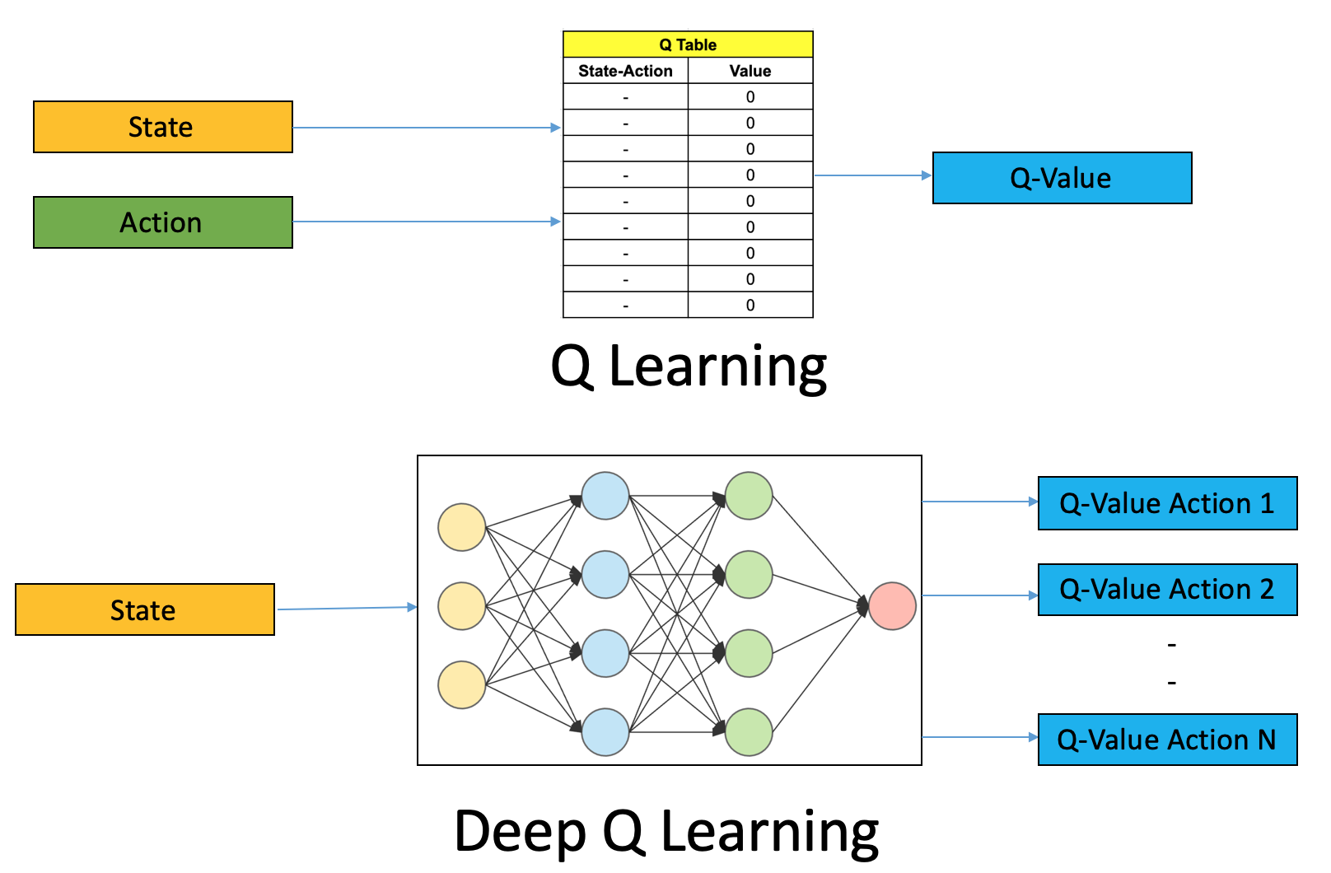
Deep RL - a solution to large state space

Slide 19
Disclaimer
Just for introduction.
For further learning or concrete math, plz refer to Reference
Feel free to ask question

Slide 20
Reference
David Silver’s RL course - Intro to RL, MDP, DP part
Wild ML’s RL coding practice
pictures are from the web, for educational usage only.

Slide 21
Thank you for listening!

